Slide 1
Dual Ecal
Lafe Spietz
NIST
November 2025

Slide 2
Improvements/Features
Switch from 4 layer to 2 layer RF board for rapid prototyping
One micro D for whole system with two switches
Single compact switch for both sides
Two paths for quantum devices, one for thru
Built in SOLT
Repeat offset short calibration to get cal plane at SMA’s
Inner/outer symmetry
Matching network
Easily fits in narrow bore fridge with magnetic shield
Same board works with chips and wire bonds as with SMA edge launch
ALL SMA, no SMP

Slide 3
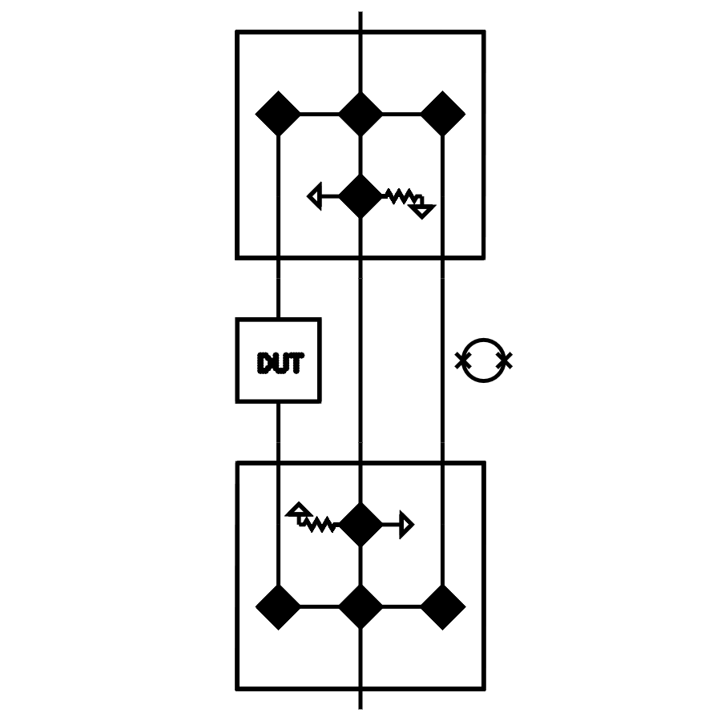
SOLT + qubit power sensor
Vs.
DUT

Slide 4
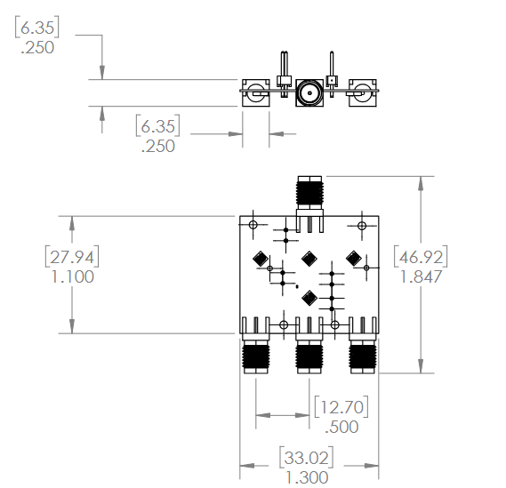
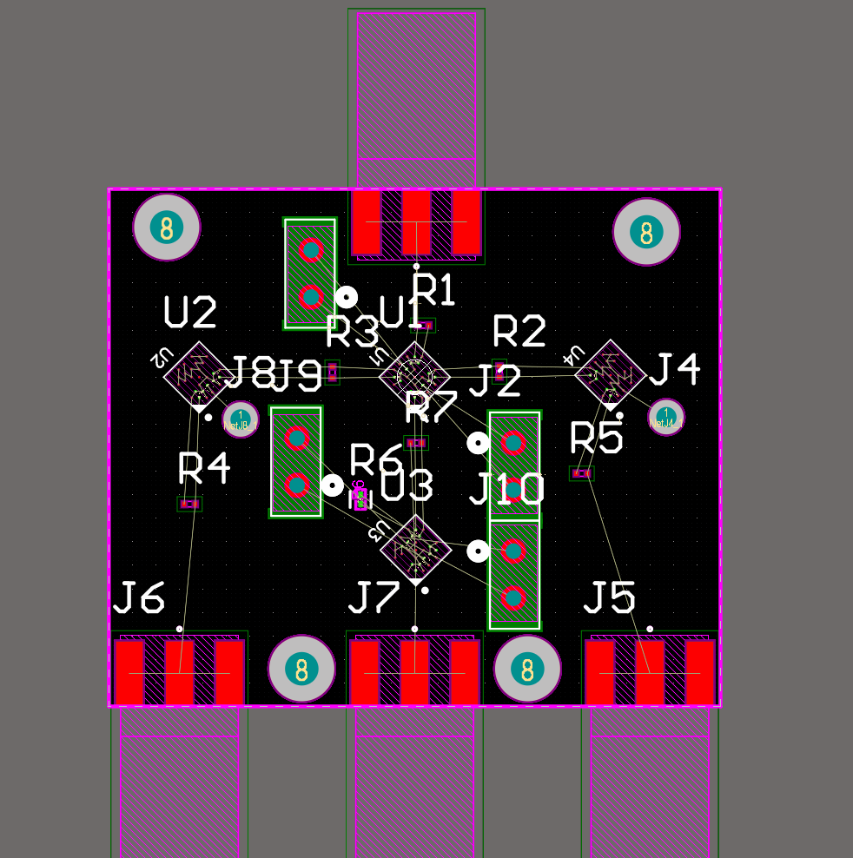
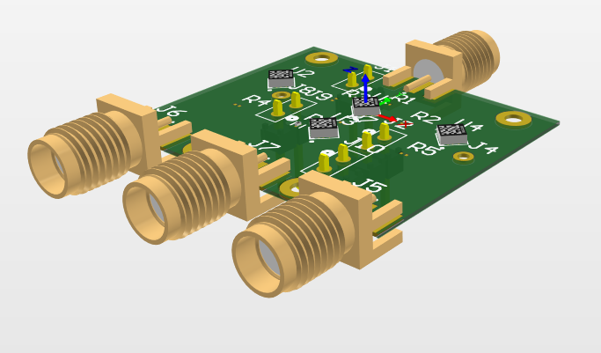
Single Pole 3 Throw E-CAL

Slide 5
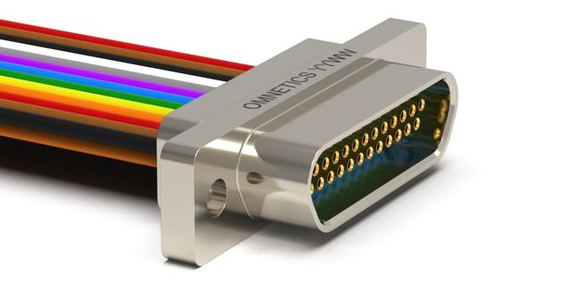
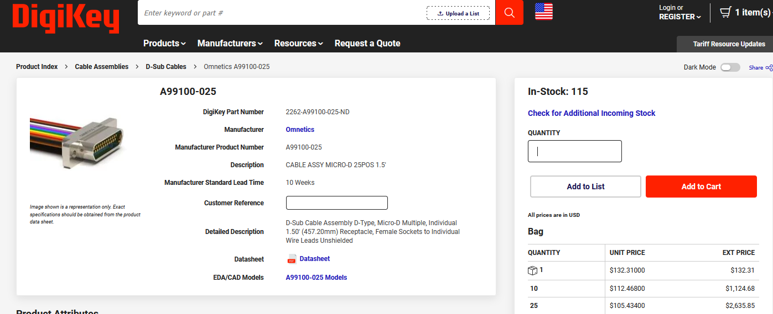
Female 25 pin Micro D pigtail
https://www.digikey.com/en/products/detail/omnetics/A99100-025/11697551

Slide 6
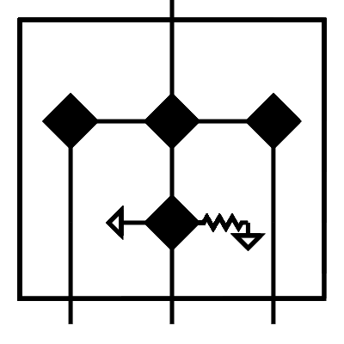
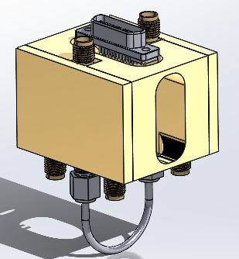
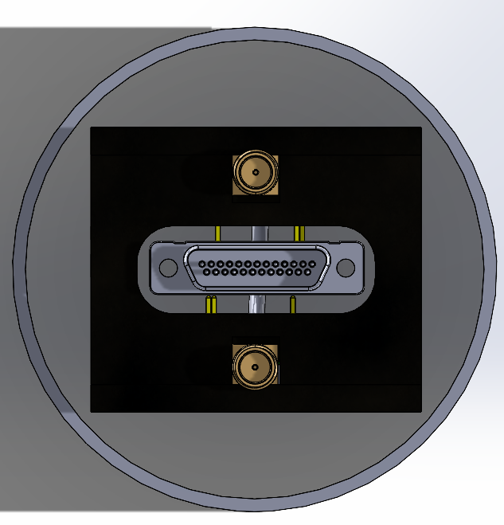
Full package
THRU
Fits in 2.5” I.D tube

Slide 7
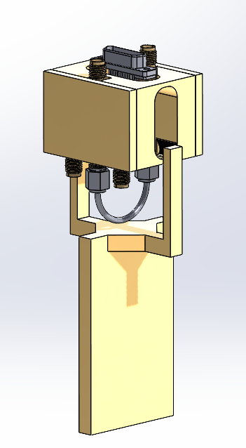
Bracket for 2 chip enclosures

Slide 8
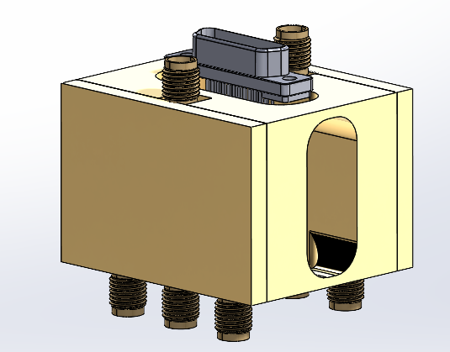
Chip based tester with integrated enclosure
END CAP PCB WITH CHIP CUTOUTS, THRU HOLE VIAS, NO SMA

